Slide 1
The 10
Commandments

Slide 2
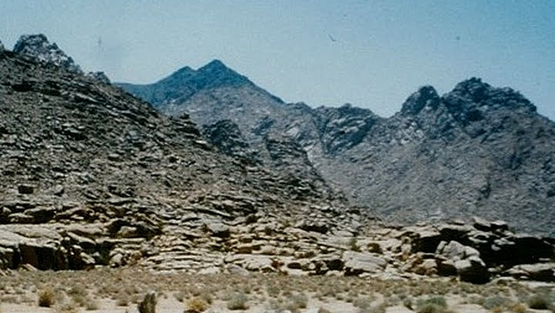
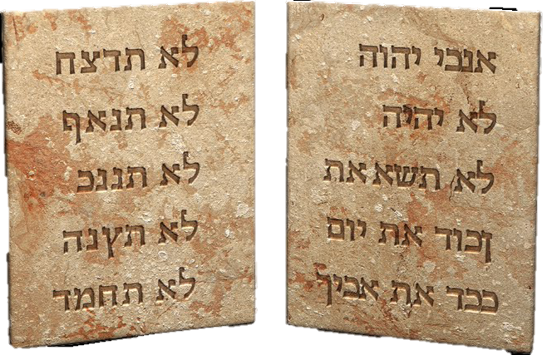
Notes:
2

Slide 3
The Commandments
(in Jewish Tradition and Yeshuas time)
First Commandment (Exodus 20:2)
I am the Lord Your God, who brought you out of the land of Egypt, out of the house of bondage.
Second Commandment (Exodus 20:3-6)
You shall have no other gods beside Me. You shall not make for yourself any graven image, nor any manner of likeness, of any thing that is heaven above, or that is in the earth beneath, or that is in the water under the earth. You shall not bow down to them, nor serve them, for I, the Lord Your God, am a jealous God, visiting the iniquity of the fathers upon the children unto the third and fourth generation.
Third Commandment (Exodus 20:7)
You shall not take the name of the Lord Your God in vain; for the Lord will not hold him guiltless that takes His name in vain.
Fourth Commandment (Exodus 20:8-11)
Remember the Sabbath, to keep it holy. Six days you shall labor, and do all your work; but the seventh day is a Sabbath unto the Lord Your God, in it you shall not do any manner of work, you, nor your son, nor your daughter, nor your man-servant, nor your maid-servant, nor your cattle, nor your stranger that is within your gates; for in six days the Lord made heaven and earth, the sea, and all that in them is, and rested on the seventh day. Wherefore the Lord blessed the Sabbath day, and made it holy.
Fifth Commandment (Exodus 20:12)
Honor your father and your mother, that your days may be long upon the land which the Lord God gives you.
Sixth Commandment (Exodus 20:13)
You shall not murder.
Seventh Commandment (Exodus 20:13)
You shall not commit adultery.
Eighth Commandment (Exodus 20:13)
You shall not steal.
Ninth Commandment (Exodus 20:13)
You shall not bear false witness against your neighbor.
Tenth Commandment (Exodus 20:14)
You shall not covet your neighbor’s house, nor his wife, his man-servant, his maid-servant, nor his ox, nor his ass, nor anything that is your neighbor’s.

Slide 4
The first 3
1
2
3
Love God

Slide 5
1
And God spoke all these words, saying,
I am יְהֹוָה YEHOVA your God, which have brought you out of the land of Egypt, out of the house of bondage. (You shalt have no other gods before me.)
Exodus 20:2+3

Slide 6
1st commandment
1
1Nagsiling ang Dios, 2“Ako ang Ginoo nga inyo Dios nga nagpaguwa sa inyo sa Egipto nga sa diin kamo gin-ulipon.

Slide 7
1
Have you been in Egypt?
So it does not count for you?

Slide 8
1
Rev 11:8 about the 2 witnesses
And their dead bodies (shall be) in the street of the great city, which spiritually is called Sodom and Egypt, where also our Lord was crucified.

Slide 9
1
In this case Egypt is Jerusalem where Yeshua was crucified.
Because it is in bondage. There eyes are covered with a vail. Rom 11:25 And the Pharisees are still ruling over the Israelis.

Slide 10
1
אֲדֹנָי יְהֹוָה
Wherever there is bondage in this world there is spiritually spoken Egypt. There is also a vail over all nations. (Isa 25:7) And all rulers and Kings of the world conspire against GOD and HIS anointed. (Psa 2)
God bought you out from bondage to serve Yeshua.
Notes:
Isa 25:7 And he will destroy in this mountain the face of the covering cast over all people, and the vail that is spread over all nations.
Psalms 2:2 The kings of the earth set themselves, and the rulers take counsel together, against the LORD, and against his anointed,
10

Slide 11
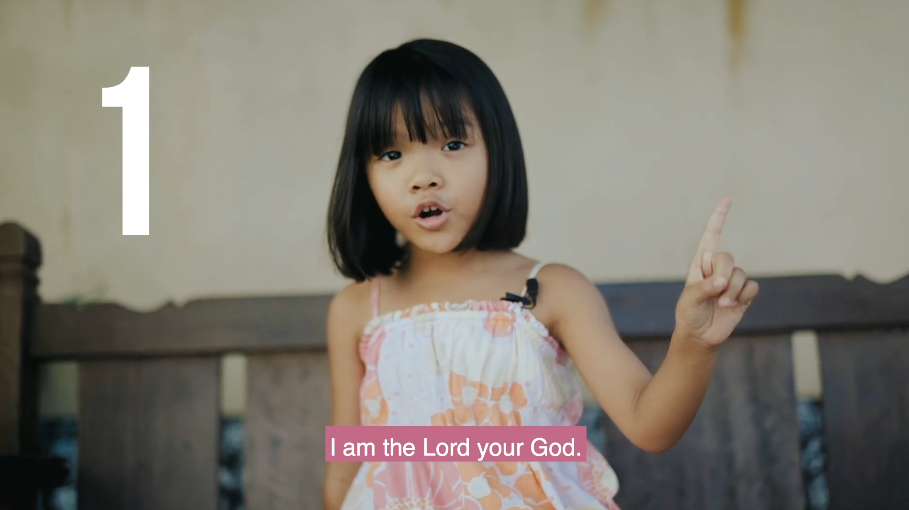

Slide 12
The 2nd
Commandment

Slide 13
2
Things that Steal your heart
3 You shalt have no other gods before me.
4 Thou shalt not make unto thee any graven image, or any likeness that in heaven above, or that in the earth beneath, or that in the water under the earth:
5 Thou shalt not bow down thyself to them, nor serve them: for I the LORD thy God a jealous God, visiting the iniquity of the fathers upon the children unto the third and fourth of them that hate me;
6 And shewing mercy unto thousands of them that love me, and keep my commandments.

Slide 14
2nd commandment
2
3“Indi kamo magsimba sa iban nga dios magluwas sa akon. 4“Indi kamo maghimo sang mga dios-dios sa dagway sang bisan ano nga ara sa langit, ukon sa duta, ukon sa tubig. 5Indi gid ninyo ini pag-alagaron kag simbahon, kay ako, ang Ginoo nga inyo Dios, indi gid gusto nga may ginasimba kamo nga iban. Ginasilutan ko ang mga nakasala sa akon pati ang ila mga kaliwat hasta sa ikatatlo kag ikaapat nga henerasyon nga nagasikway sa akon. 6Pero ginapakita ko ang akon kaayo sa madamo gid nga mga henerasyon nga nagahigugma sa akon kag nagatuman sang akon mga sugo.

Slide 15
2
Things that have power over you
Images from פֶסֶל
תְּמוּנָה
Likeness of above in Heaven
Likeness of up on Earth
Likeness of in under Sea

Slide 16
2
OK I am brought out of bondage, so out of Egypt. What are Gods?
From the Hebrew word El אל a God is a mighty usually immortal one and many Gods are called Elohim אֱלֹהִים which is also the Title of our GOD as a divine Plural as referred to a single person. (God is one. Deu 6:4) Psalm 82:6 calls people Gods but they are mortal.
Notes:
Psalms 82:1 A Psalm of Asaph. God standeth in the congregation of the mighty; he judgeth among the gods.
2 How long will ye judge unjustly, and accept the persons of the wicked? Selah.
3 Defend the poor and fatherless: do justice to the afflicted and needy.
4 Deliver the poor and needy: rid out of the hand of the wicked.
5 They know not, neither will they understand; they walk on in darkness: all the foundations of the earth are out of course.
6 I have said, Ye gods; and all of you children of the most High.
[ALP] Deuteronomy 6:4 שְׁמַע יִשְׂרָאֵל יְהוָה אֱלֹהֵינוּ יְהוָה אֶחָד
7 But ye shall die like men, and fall like one of the princes.
8 Arise, O God, judge the earth: for thou shalt inherit all nations.
16

Slide 17
2
God
Any mighty one is a God, but their power is not rightfully taken. Only our GOD has rightfully all power. And we lay down our crowns and life's before HIM.
All power is given unto me in heaven and in earth. Mt 28:18b

Slide 18
2
Beware of other Gods
Therefore let not one rule over you except Yeshua!
Like Mordochai do not bow down to anyone
Be there, for GOD and HIS KING

Slide 19
2
Your appearance to things
No sign of submission
So servitude

Slide 20
2
People who failed this command
All Kings of Israel and
all Kings of Juda except 4
Shlomo Ben David

Slide 21
2
What can hinder you?
Earthly wisdom
Girls and their religion
Business
No connection with GOD

Slide 22
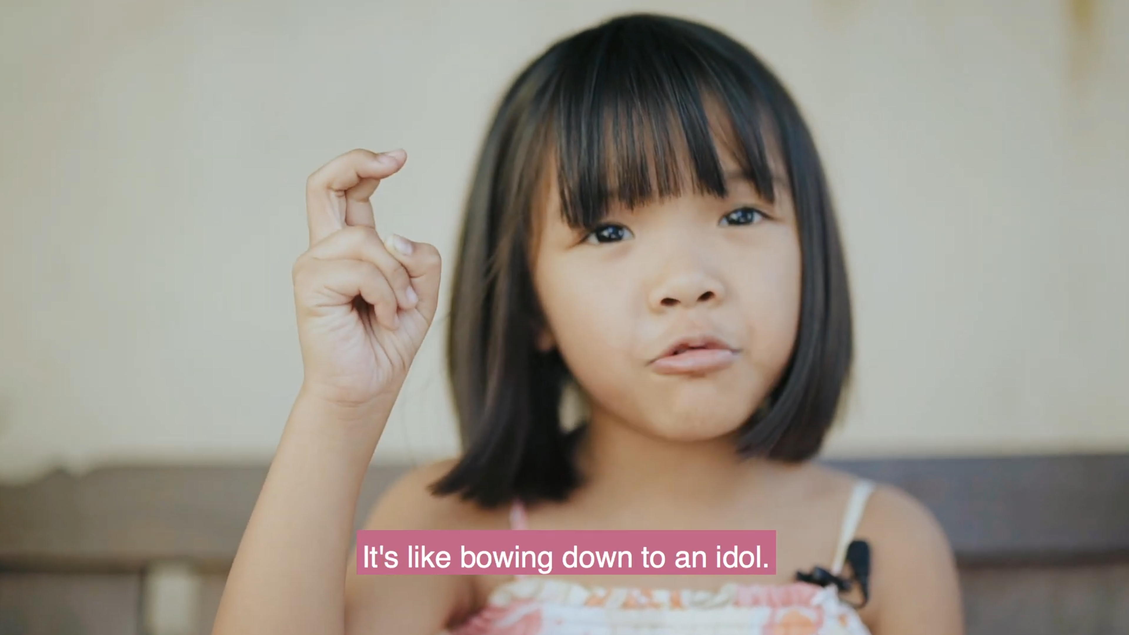
2

Slide 23
3rd Commandment
The 3rd
commandment

Slide 24
3
Exodus 20:7
Thou shalt not take the name of YEHOVA your God in vain;
for YEHOVA will not hold him guiltless that takes his name in vain.

Slide 25
3rd commandment
3
“Indi ninyo paggamita ang akon ngalan sa wala sing pulos kay ako, ang Ginoo nga inyo Dios, magasilot sa kay bisan sin-o nga maggamit sang akon ngalan sa wala sing pulos.”

Slide 26
3
Exodus 20:24b
In all places
where I record my name
I will come unto you,
and I will bless you.

Slide 27
3
Himuon ninyo ini sa
lugar nga akon ginpili nga pagasimbahon ako, kag didto kadtuan ko kamo kag bendisyunan.

Slide 28

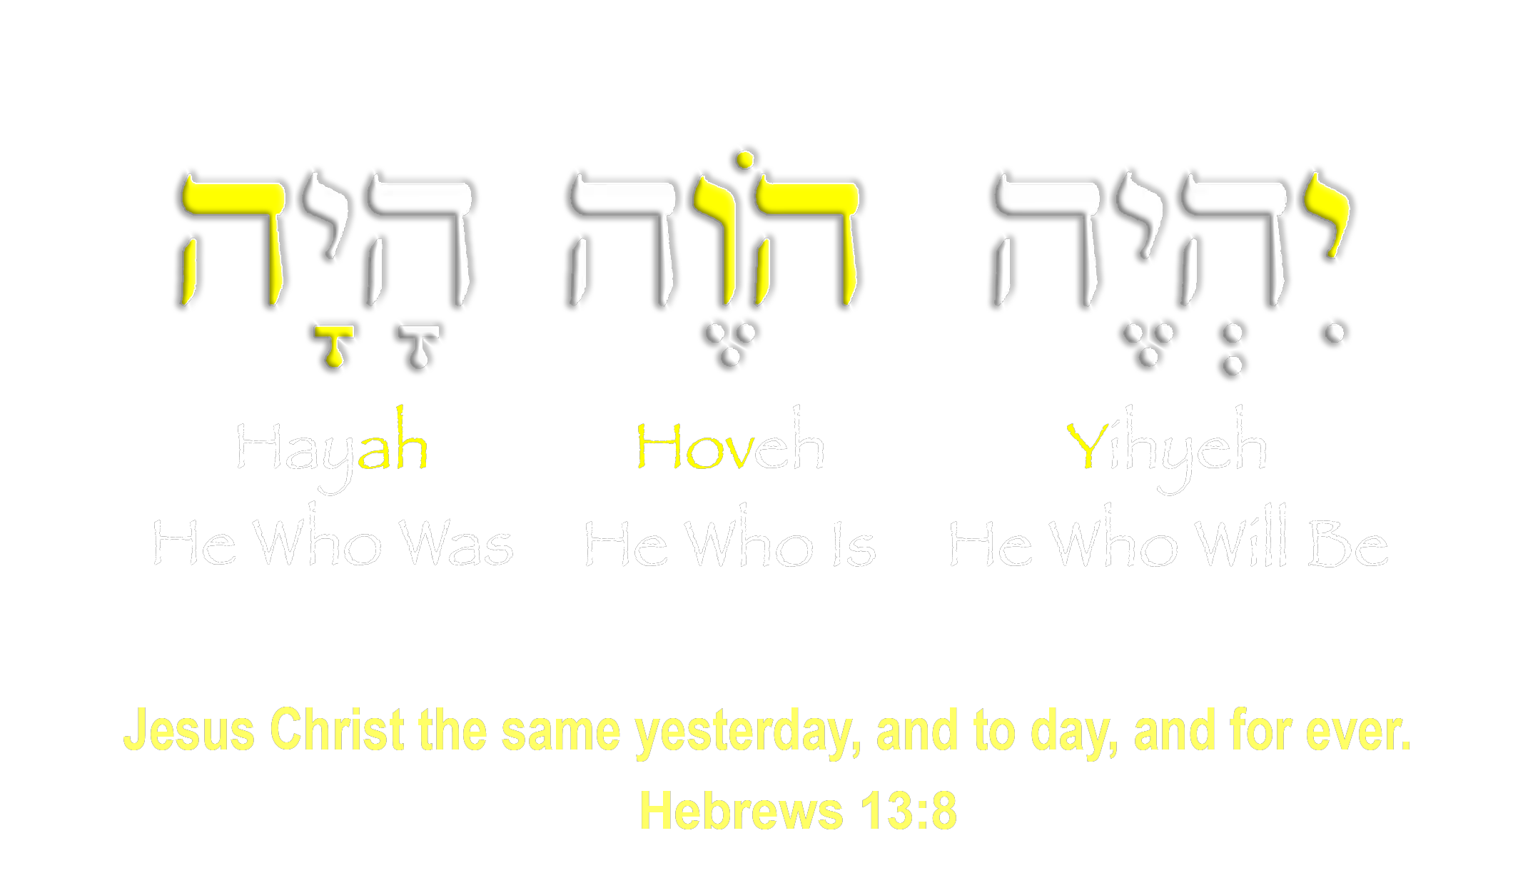
3
יְהֹוָה
Notes:
28

Slide 29
3
Hebrews 13:8
Yeshua Messiah
is the same
yesterday, and today, and for ever.

Slide 30
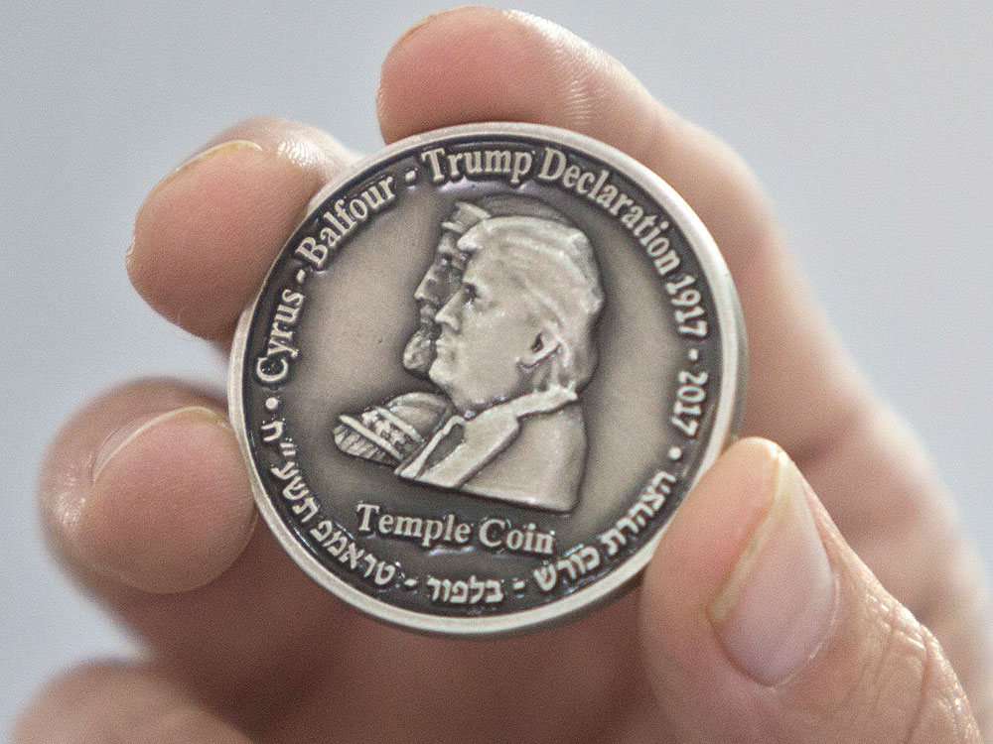
3

Slide 31
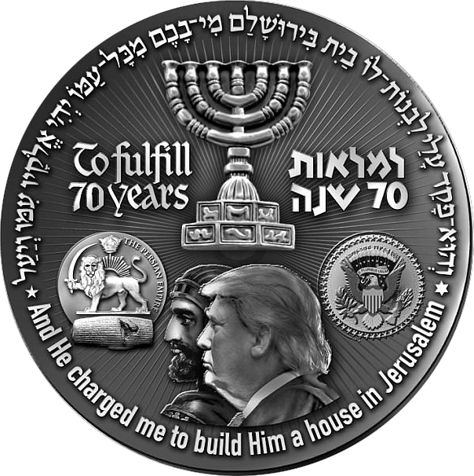
3

Slide 32
3
What else does GOD expect from us?

Slide 33
3
Isaiah 58:5
Is it such a fast that I have chosen? a day for a man to afflict his soul? to bow down his head as a bulrush, and to spread sackcloth and ashes ? wilt thou call this a fast, and an acceptable day to יְהֹוָה YEHOVA?

Slide 34
ISAIAS 58:5
3
Kon magpuasa kamo, nagapenetensya kamo. Nagaduko ang inyo mga ulo nga daw sa mga kugon, kag nagahigda kamo sa abo nga nagasuksok sang sako. Amo bala ina ang ginatawag ninyo nga puasa? Nagahunahuna bala kamo nga makapalipay ina sa akon?

Slide 35
3
6
is not this the fast that I have chosen?
to loose the bands of wickedness, to undo the heavy burdens, and to let the oppressed go free, and that you break every yoke?

Slide 36
ISAIAS 58:6
3
Ang klase sang puasa nga luyag ko amo ang puasa nga ginaupdan sining matarong nga mga pagginawi: Ginauntatan ninyo ang pagpamigos kag ang pagpangpriso sa mga inosente, kag ginahilway ninyo ang mga ginapigos

Slide 37
3
7
not to deal your bread to the hungry, and that thou bring the poor that are cast out to your house? when you see the naked, that you cover him; and that you hide not thyself from your own flesh?

Slide 38
ISAIAS 58:7
3
Ginahatagan ninyo sang pagkaon ang mga ginagutom, ginapaestar ninyo sa inyo mga balay ang mga wala sing elistaran, ginapabayuan ninyo ang mga wala sing bayo, kag ginabuligan ninyo ang inyo mga paryente.

Slide 39
3
8
Then shall your light break forth as the morning, and your health shall spring forth speedily: and your righteousness shall go before you; the glory of יְהֹוָה YEHOVA shall be your reward.

Slide 40
ISAIAS 58:8
3
Kon himuon ninyo ini, magaabot sa inyo ang kaluwasan pareho sang nagabutlak nga adlaw, kag ayuhon ko kamo gilayon. Ako, nga inyo matarong nga Dios, magauna sa inyo kag protektaran ko kamo sang akon gamhanan nga presensya.

Slide 41
3
9
Then shalt you call, and YEHOVA shall answer; you shalt cry, and he shall say, “Here I am”. If you take away from the midst of you the yoke, the putting forth of the finger, and speaking vanity;

Slide 42
ISAIAS 58:9
3
Kon magpanawag kamo sa akon sa pagpangayo sang bulig, sabton ko kamo.
“Kon untatan na ninyo ang pagpamigos, ang pag-akusar sang indi matuod, kag ang paghambal sang malain, …

Slide 43
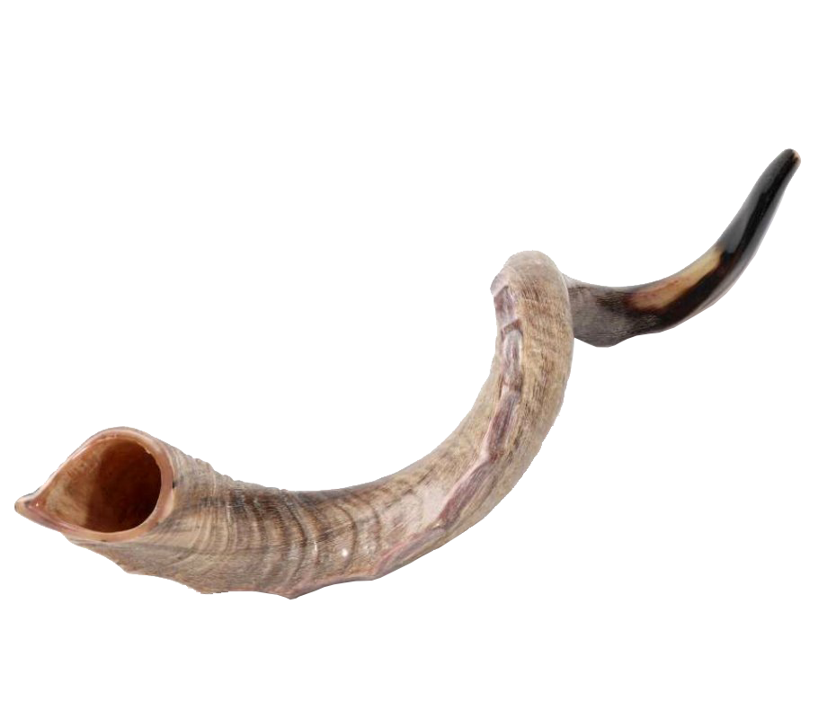
3
Shofar

Slide 44
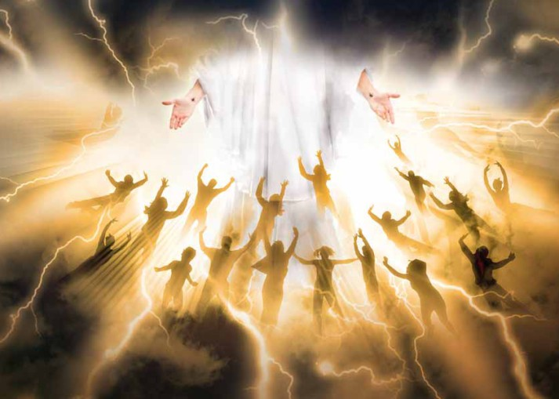

Slide 45
The first 3
1
2
3
Love God

Slide 46
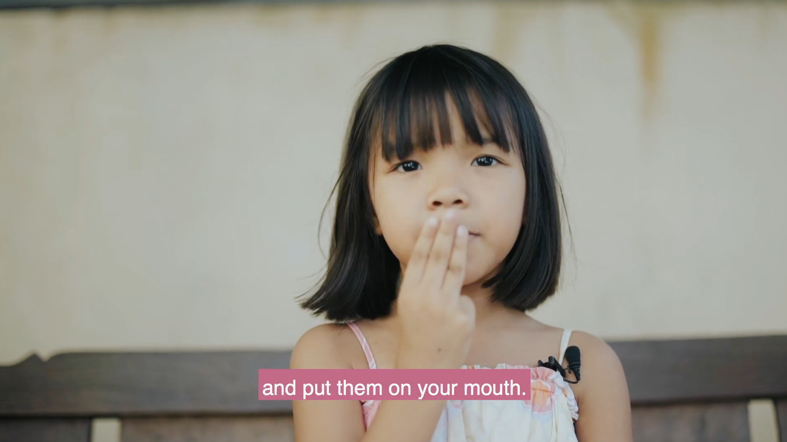
3

Slide 47
The 4th
commandment
Notes:
47

Slide 48

4
Remember to meet God
on the Day He blessed
1
2
3
4
5
6
HIS Day
Your Day
2
3
4
5
6
7

Slide 49
4
The rest of GOD
8 Remember the sabbath day, to keep it holy.
9 Six days shalt thou labour, and do all thy work:
10 But the seventh day the sabbath of יְהֹוָה thy God: thou shalt not do any work, thou, nor thy son, nor thy daughter, thy manservant, nor thy maidservant, nor thy cattle, nor thy stranger that within thy gates:
11 For six days יְהֹוָה YEHOVA made heaven and earth, the sea, and all that in them , and rested the seventh day: wherefore יְהֹוָה YEHOVA blessed the sabbath day, and hallowed it.
Notes:
Certainly it is totally wrong to rest when our father rests we will just watch His sleep and rest another day >>> ???
Well where is your relation to your father?
49

Slide 50
4th commandment
4
⁸ “Tumana ninyo ang akon mga ginapahimo sa Adlaw nga Inugpahuway, kag himua ninyo ini nga pinasahi nga adlaw para sa akon. ⁹ Mag-obra kamo sa sulod sang anom ka adlaw, ¹⁰ pero ang ikapito nga adlaw amo ang Adlaw nga Inugpahuway nga inyo painon para sa akon, ang Ginoo nga inyo Dios. Indi kamo mag-obra sa sina nga adlaw pati ang inyo mga anak, mga ulipon, mga kasapatan, kag ang mga indi Israelinhon nga nagaestar sa inyo mga banwa. ¹¹ Kay sa sulod sang anom ka adlaw gintuga ko ang kalangitan, ang duta, ang dagat kag ang tanan nga ara sa ila, pero nagpahuway ako sa ikapito nga adlaw. Gani ginbendisyunan ko ang Adlaw nga Inugpahuway kag ginhimo nga pinasahi nga adlaw para sa akon.

Slide 51
4
What is our Situation

Slide 52
4
Where does it come from
the Jews made the Sabbath a fast day, while in Rome Sunday was a feast day.
  [TR+] Luke 18:12 νηστευω δις του σαββατου αποδεκατω παντα οσα κτωμαι
The Roman Catholic Church kept Pegan Sunday practice
Constantin II the great had confirmed that day
in the Council of Laodicea (4th century AD) Sabbath was forbidden in Canons 37–38

Slide 53
4
Manuscripts
Notes:
53

Slide 54
4
Translations
German Luther
Polish

Slide 55
4
Tranlation of Shabbaton
שַׁבָּתוֹן

Slide 56
4
The day Yeshua rose from death
In the end of the sabbath, as it began to dawn toward the first of the week, came Mary Magdalene and the other Mary to see the sepulchre.
[KJV+] Matthew 28:1
πρεσαββατον
preparation
Γενόμενος
preparation
1
2
Dearth
Sabbath
Rishon

Slide 57
Passover
Unleavened Bread
Firstfruits
Day 1 Sunday
Day 2 Monday
Day 3 Tuesday
Day 5 Thursday
Day 6 Friday
Day 7 Sabbath
Day 4 Wednesday
Notes:
57

Slide 58
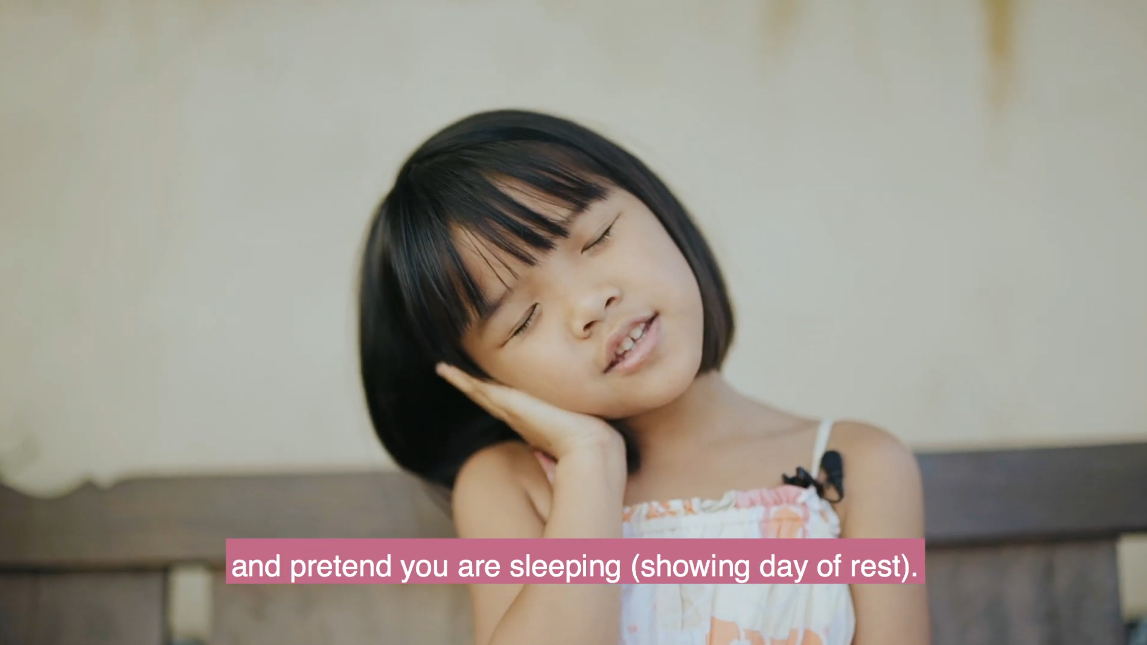
4

Slide 59
The 5th
commandment
Honour thy father and thy mother: that thy days may be long upon the land which the LORD thy God giveth thee.
Notes:
59

Slide 60
Honour thy father and thy mother: that thy days may be long upon the land which YeHoVaH יְהֹוָה thy God giveth thee.

Slide 61
Caring in old age
Matthew 15
Then came to Jesus scribes and Pharisees, which were of Jerusalem, saying, Why do thy disciples transgress the tradition of the elders? for they wash not their hands when they eat bread. But he answered and said unto them, Why do ye also transgress the commandment of God by your tradition? For God commanded, saying, Honour thy father and mother: and, He that curseth father or mother, let him die the death.

Slide 62
Caring in old age
Matthew 15
But ye say, Whosoever shall say to his father or his mother, It is a gift, by whatsoever thou mightest be profited by me; And honour not his father or his mother, he shall be free. Thus have ye made the commandment of God of none effect by your tradition. Ye hypocrites, well did Esaias prophesy of you, saying, This people draweth nigh unto me with their mouth, and honoureth me with their lips; but their heart is far from me. But in vain they do worship me, teaching for doctrines the commandments of men.

Slide 63
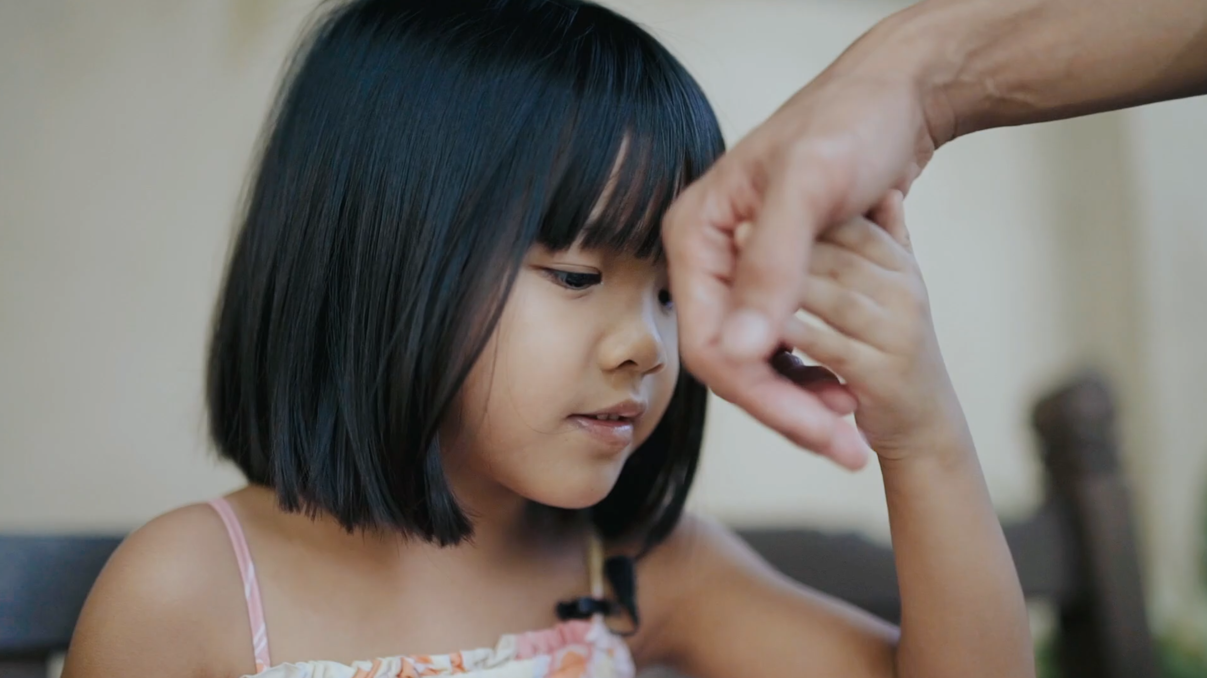
5

Slide 64
The 6th
commandment
Notes:
64

Slide 65
Thou shalt not kill.

Slide 66
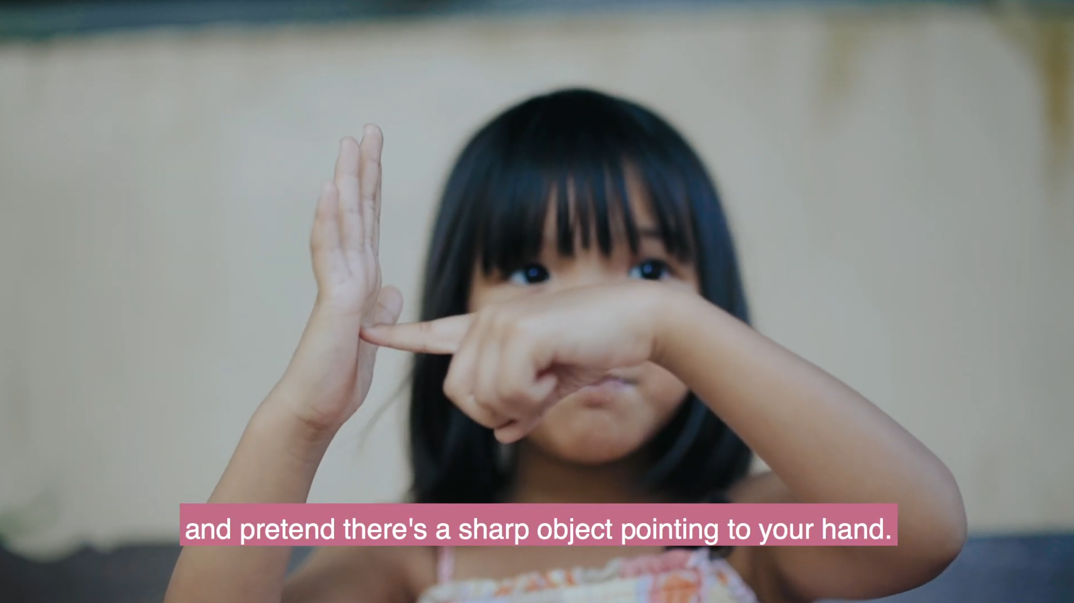
6

Slide 67
The 7th
commandment
Notes:
67

Slide 68
Thou shalt not commit adultery.

Slide 69
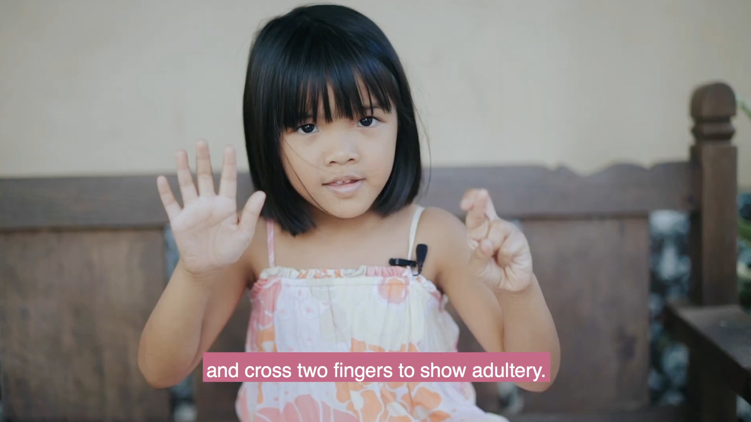
7

Slide 70
The 8th
commandment
Notes:
70

Slide 71
Thou shalt not steal

Slide 72
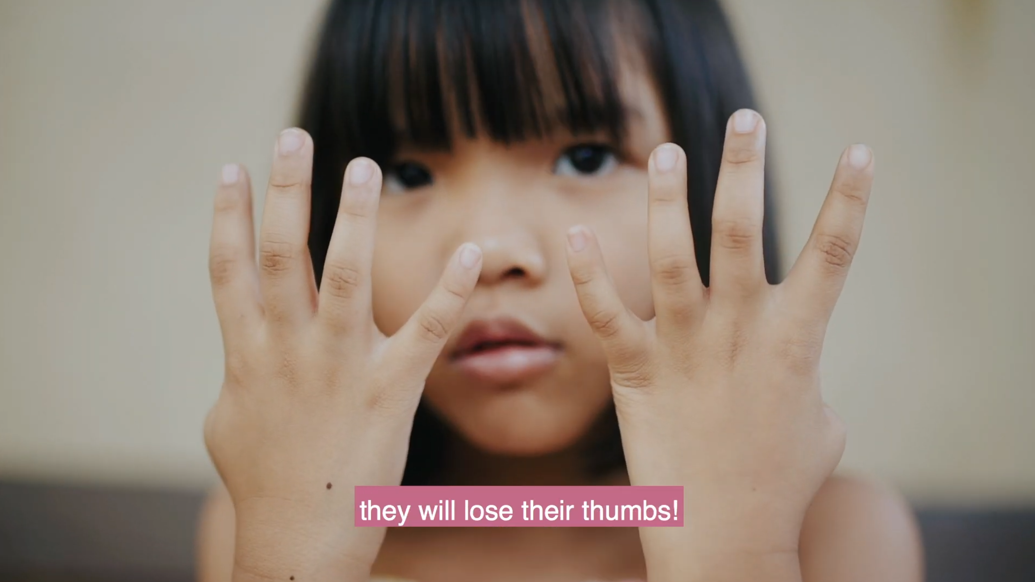
8

Slide 73
The 9th
commandment
Notes:
73

Slide 74
Thou shalt not bear false witness against thy neighbour.

Slide 75
It does not say “you should not lie”
but who invented the lie?
so whom do you want to follow?
Yeshua said I am the truth, the way and the life

Slide 76
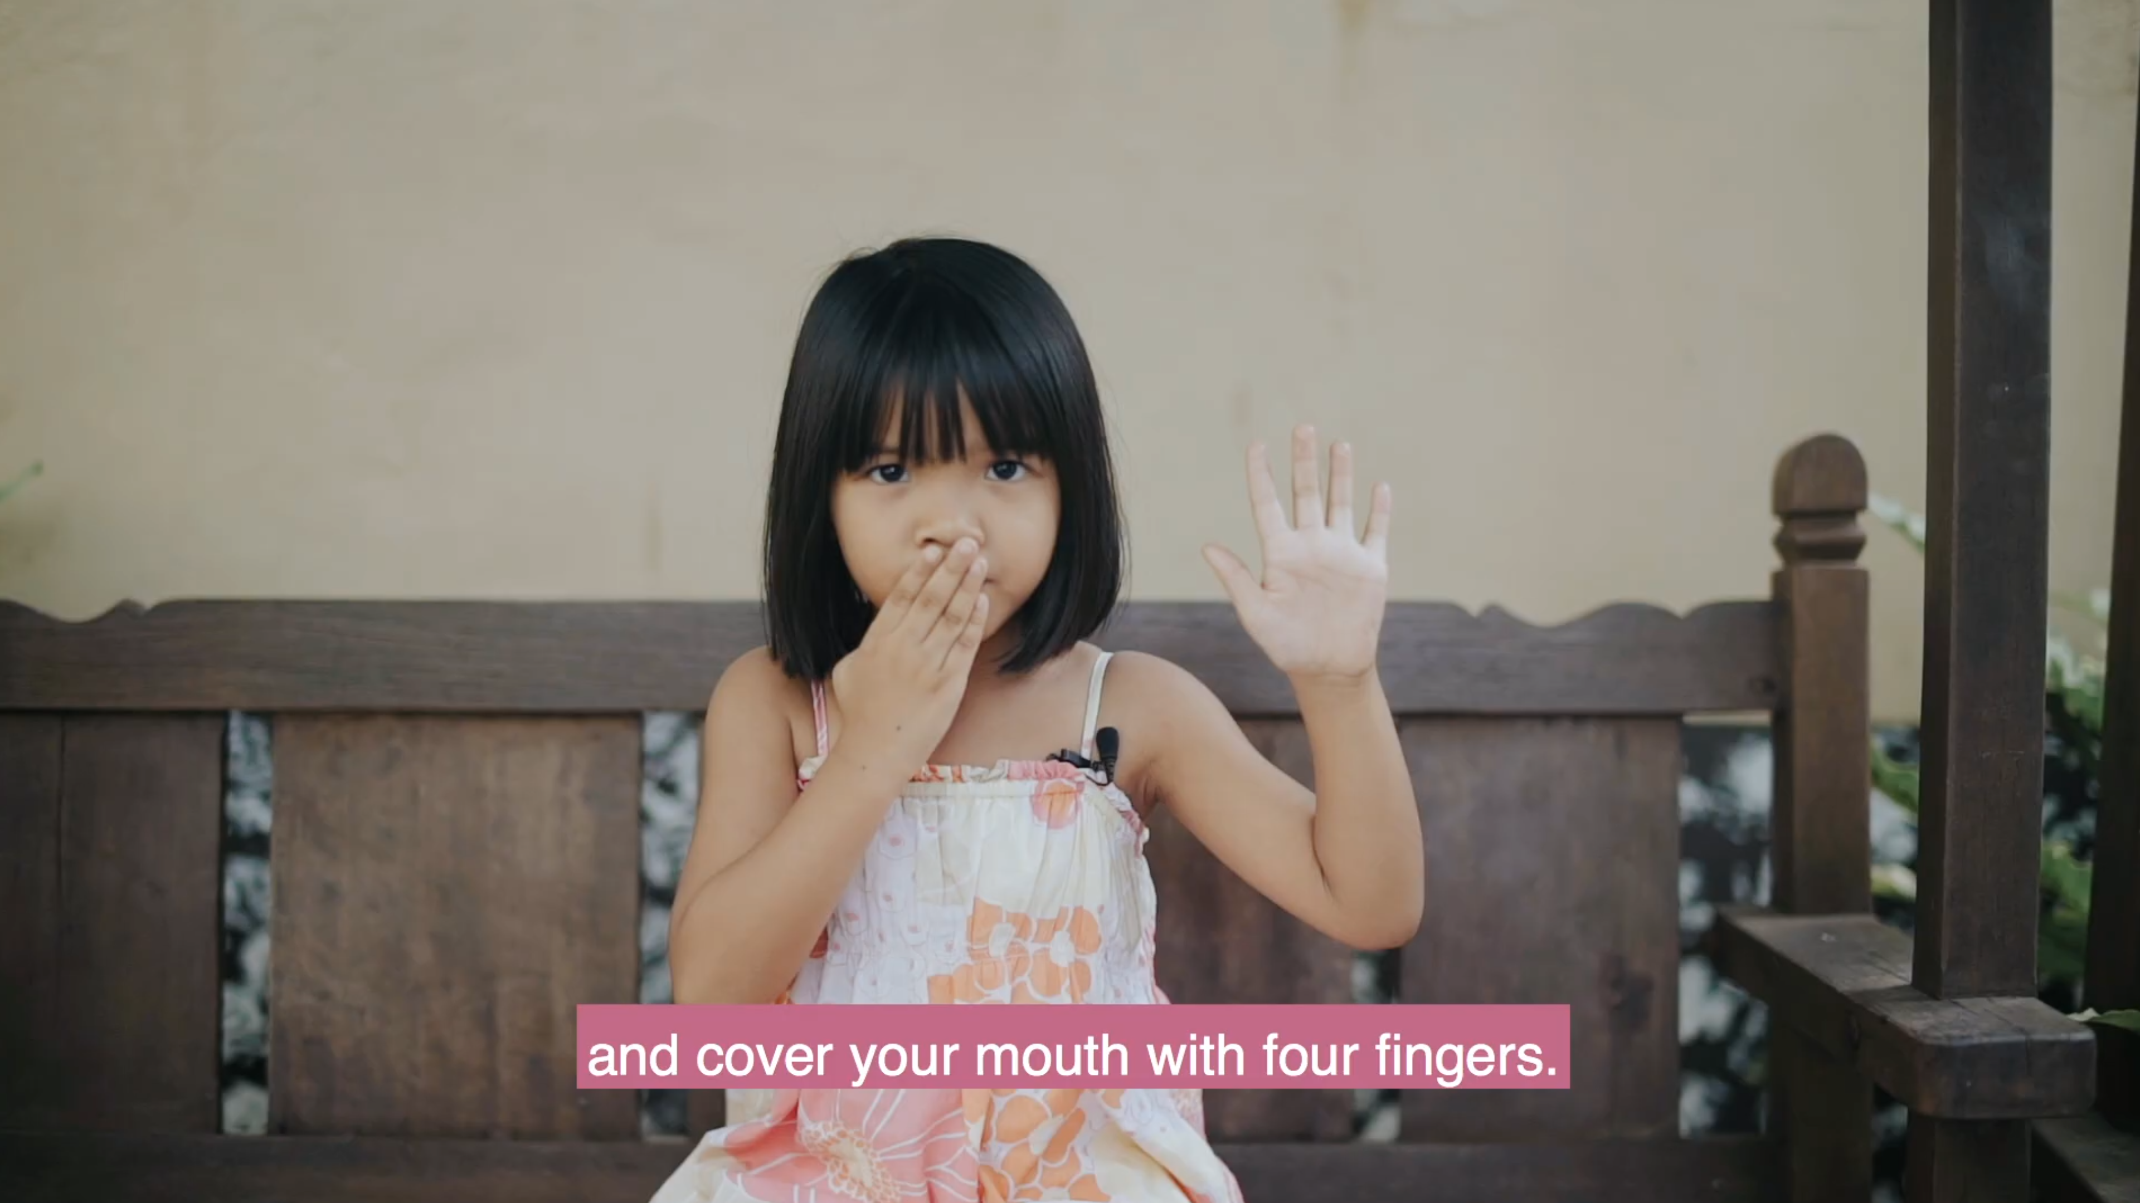
9

Slide 77
The 10th
commandment
Notes:
77

Slide 78
Thou shalt not covet
thy neighbour's house, thou shalt not covet thy neighbour's wife,
nor his manservant, nor his maidservant, nor his ox, nor his ass, nor any thing that thy neighbour's.

Slide 79
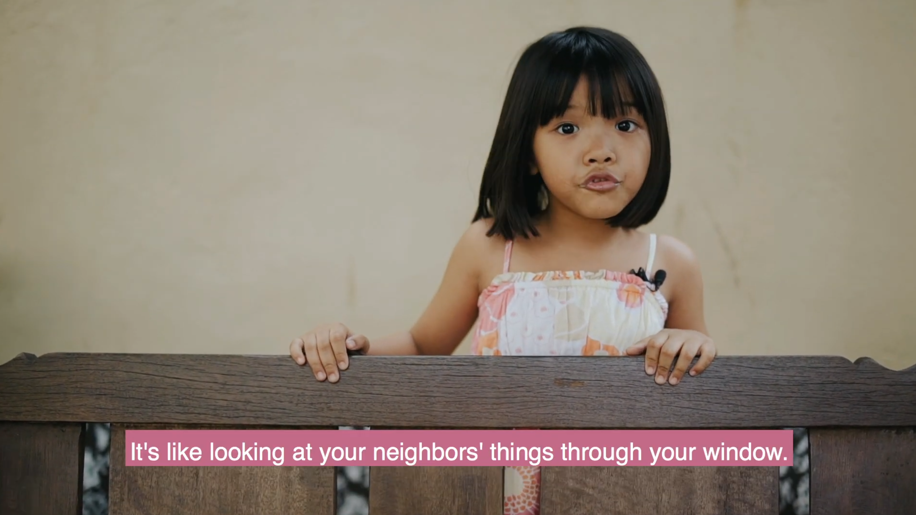
10

Slide 80
Man made or God given
18 And all the people saw the thunderings, and the lightnings, and the noise of the trumpet, and the mountain smoking: and when the people saw , they removed, and stood afar off.
19 And they said unto Moses, Speak thou with us, and we will hear: but let not God speak with us, lest we die.
20 And Moses said unto the people, Fear not: for God is come to prove you, and that his fear may be before your faces, that ye sin not.

Slide 82
